Slide 1

Covid-19 Vaccination Dashboard
Sebastian Di Francesco, Daniel Emeri, Kim Hogan, Eddie Buckalew
Notes:
Title Page: Kim

Slide 2
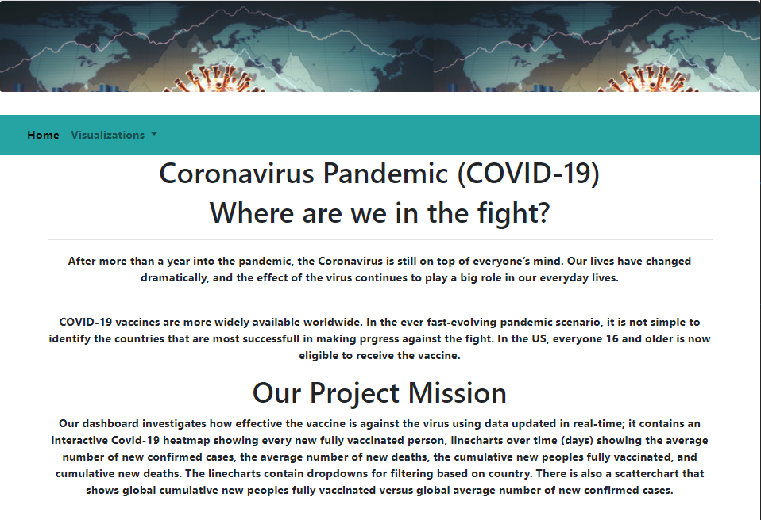
Image: Website Homepage
Notes:
Intro Project
Kim

Slide 3

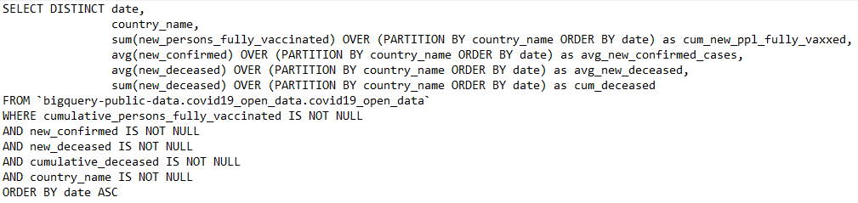
Utilizing Google Big Query To Gather Data
SQL Pull Can Extract Live Data From Google
Google BigQuery used to access data from covid19_open_data
SQL Query used for initial data pull
Link: cloud.google.com/bigquery
Notes:
BigQuery
Sebastian

Slide 4
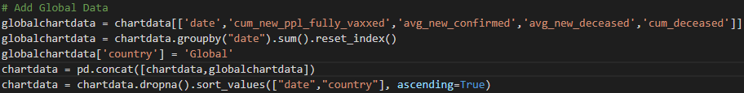
Data Cleanup To Enhance Visualization
Data combined from separate queries
Code written to combine separate metrics into one data source
Allows for analysis of global data
Data used to build line charts and scatterplot
Notes:
Sebastian

Slide 5
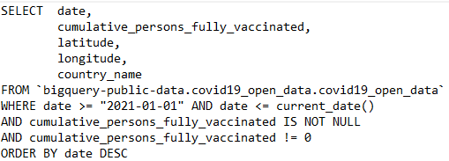
Heatmap Built Using Separate Query
Allows flexibility to update heatmap more frequently
Query used to pull heatmap data
Where date set between Jan 2021 and “current date” to allow schedule module to pull latest data
Notes:
Scraping population data and combining it with the chart data to eventually generate population_viz.csv
Eddie

Slide 6
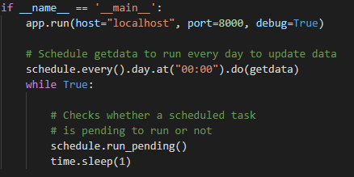
Code For Pulling Live Data
Schedule library allows for latest data to be imported
Getdata function runs SQL function and data munging daily
Once deployed it will automatically run
Notes:
Scraping population data and combining it with the chart data to eventually generate population_viz.csv
Eddie

Slide 7
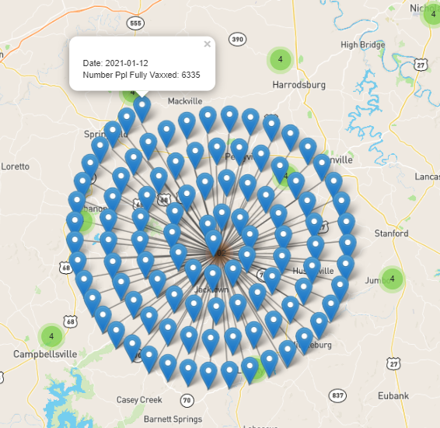
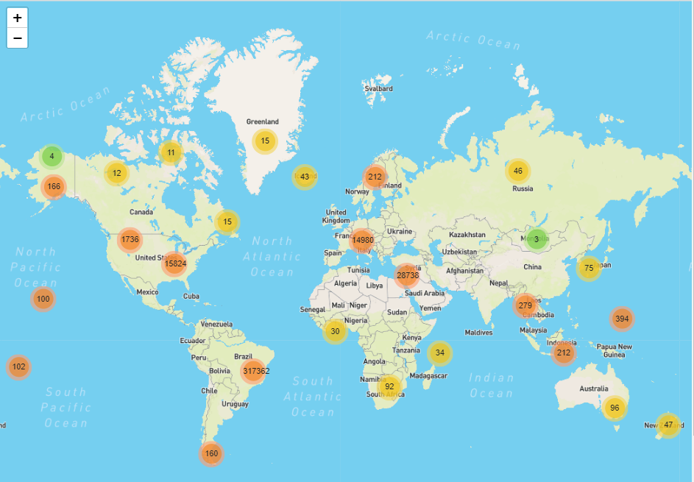
Interactive Heatmap
Where Are The Vaccinations Happening?
Heatmap uses latitude and longitude to show number of people vaccinated
Individual pins represent dates and highlight cumulative number of people fully vaccinated
Useful for seeing progress over time by location
Notes:
Dashboard Contents - Heatmap
Daniel

Slide 8
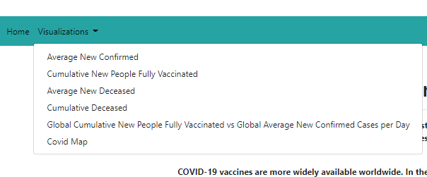
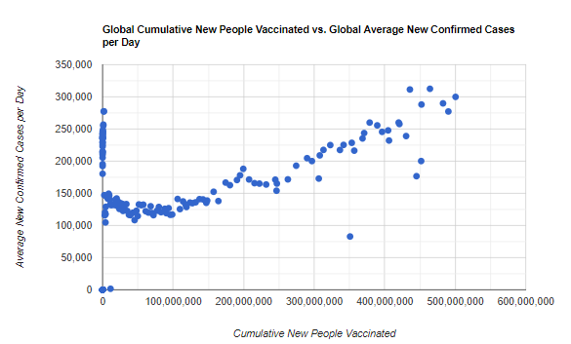
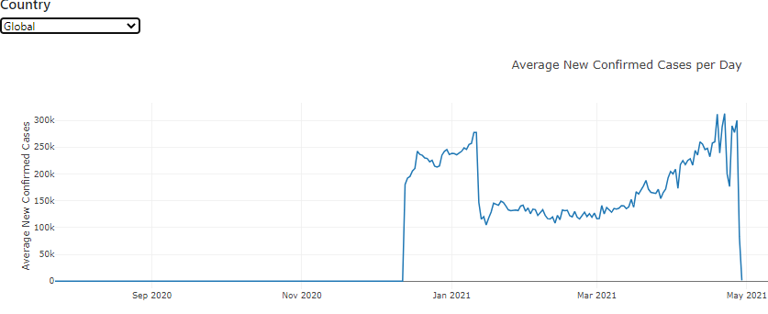
Line charts include dropdown for country selection
Additional Charts To Track Vaccine Effectiveness
As vaccinations spread, are case counts and deaths leveling off?
Dropdown to select data view
Scatter chart plots cumulative vaccinations versus new confirmed cases
Notes:
Dashboard Contents - Graphs
Daniel

Slide 9
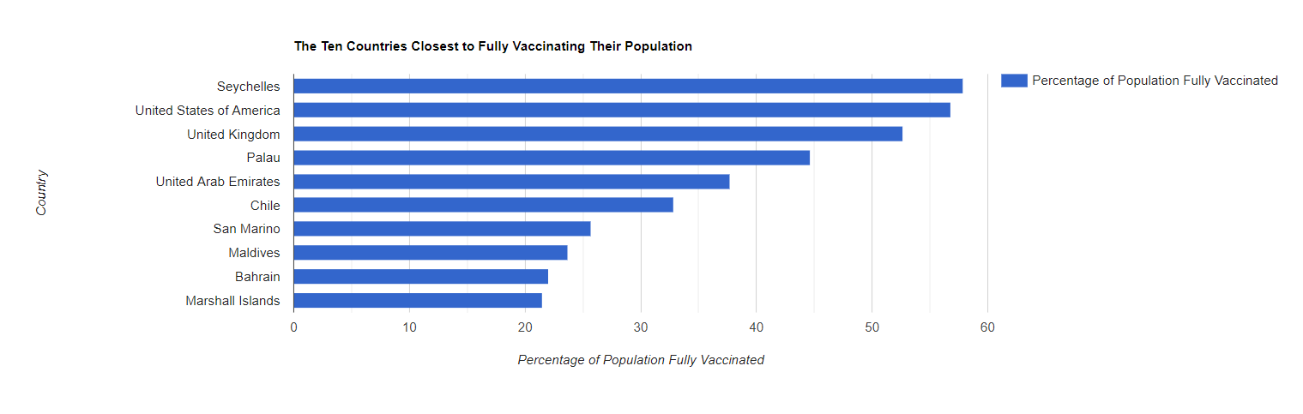
Evaluation of Covid-19 Vaccine Effectiveness
How many have been vaccinated and who’s eligible?
Top 10 countries with fully vaccinated population indicates progress toward the fight.
Eligibility for vaccination shot vary from country to county:
The WHO recommended that adults could take the vaccine.
16 years and older can get the vaccine in the US.
Notes:
Findings
Kim

Slide 10
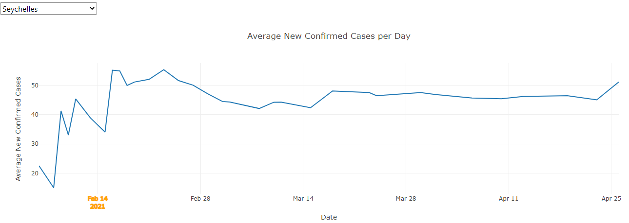
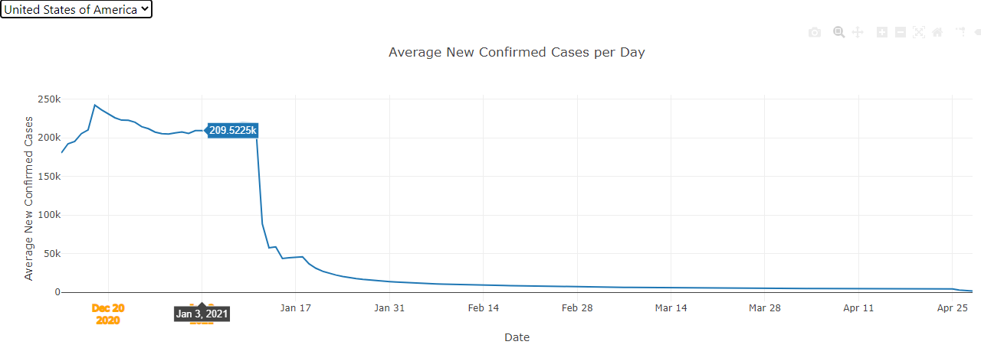
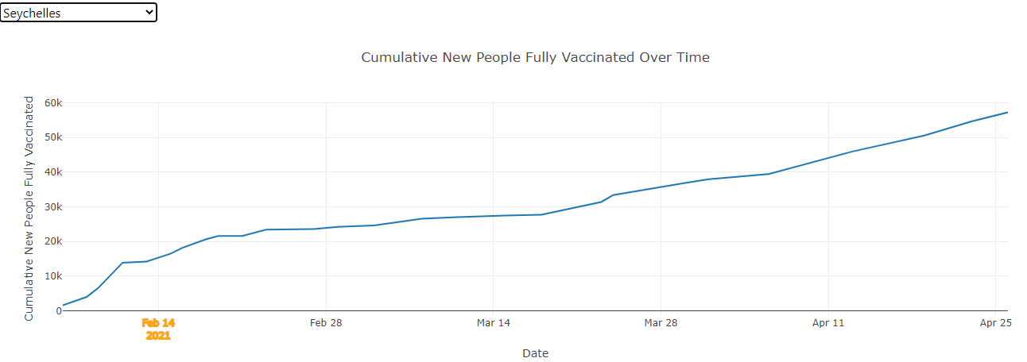
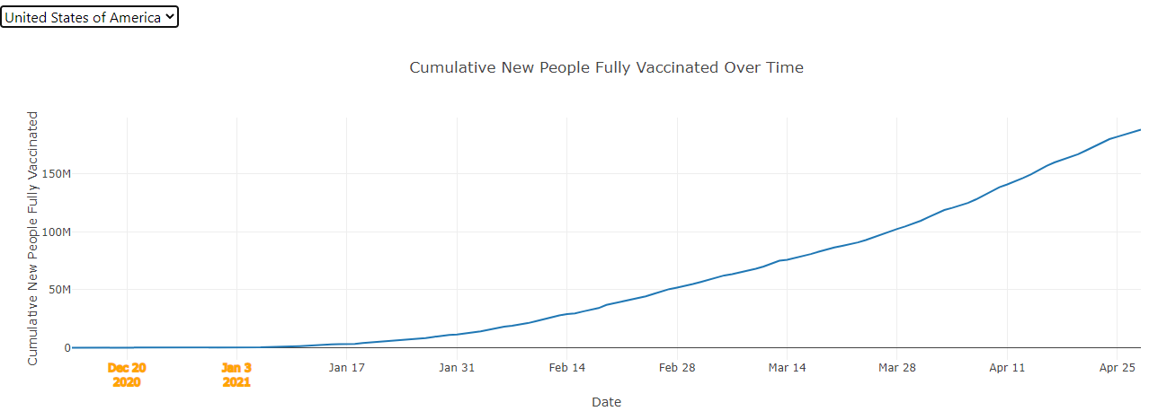
Evaluation of Covid-19 Vaccine Effectiveness
Is the vaccine effective in Seychelle? = EFFECTIVE
Is the vaccine effective in the US? = VERY EFFECTIVE
The results varies from country by country as indicates by the above linecharts.
COVID-19 vaccines are mostly effective at keeping you from getting COVID-19.
Health officials are still learning how effective the vaccines are against preventing the spread and new variants of the virus that causes COVID-19.
Notes:
Findings
Kim

Slide 11
Areas For Further Study
TRACK ACROSS TIME
Continually update data to track vaccine effectiveness across time
Develop tools allowing users to analyze data and explore
BigQuery can utilize Google search data – could a spike in searches for symptoms indicate an outbreak before it happens?
DIVE DEEPER USING STATISTICAL ANALYSES
USE SEARCH RESULT DATA TO MAKE PREDICTIONS
Notes:
Eddie

